Slide 1
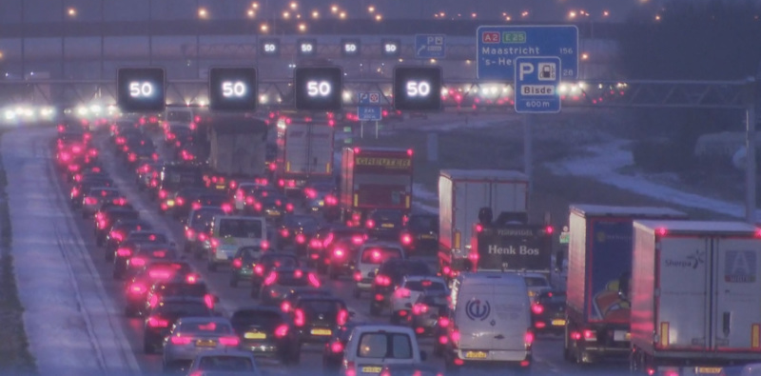
Idle project Data Science
ALTEN West
AIWeerFile
‘agAInTraffic’
Rik Bijman
Scientific Software Engineer

Slide 2


1.
Learning objectives

Slide 3
AIWeerFile
Learning objectives
Data science Skills and Apps
Data collection
API requests
Data cleaning
Python Pandas
Data storage
PostgreSQL databases
Data request
Python Flask REST API
Data visualization
Python Dash/plotly
Data analysis
Dashboard
Data modelling
Python Pandas/Scikit

Slide 4
1.
Project description

Slide 5
AIWeerFile
Learning objectives
Traffic and Weather correlation
Gather historical weather and traffic data from the web
Clean and expand the gather data
Storing the data
Request the data
Build an interactive dashboard for data inspection
Find potential correlations between traffic and weather conditions
Build predictive models for future traffic predictions
Data collection
API requests
Data cleaning
Python Pandas
Data storage
PostgreSQL databases
Data request
Python Flask REST API
Data visualization
Python Dash/plotly
Data analysis
Dashboard
Data modelling
Python Pandas/Scikit

Slide 6
1.
Design

Slide 7

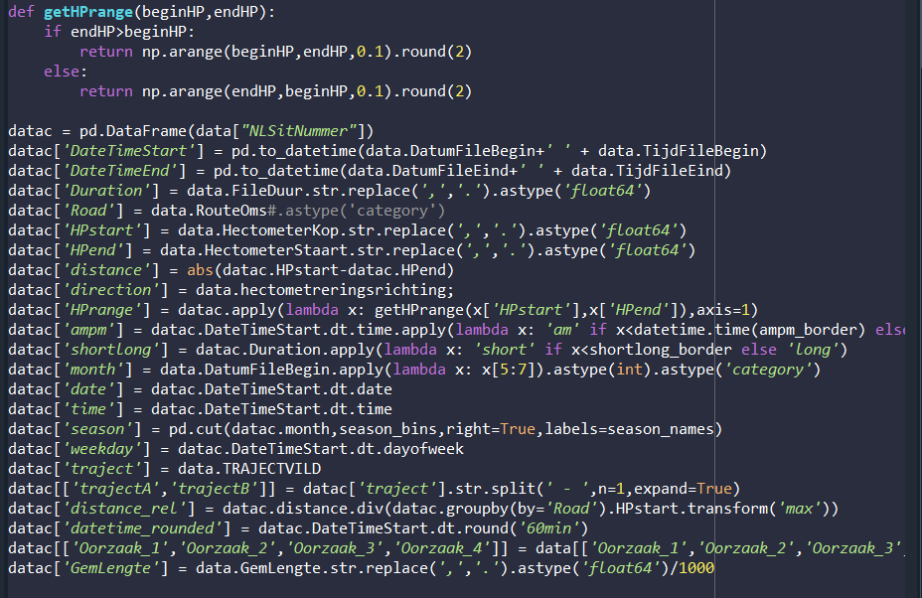
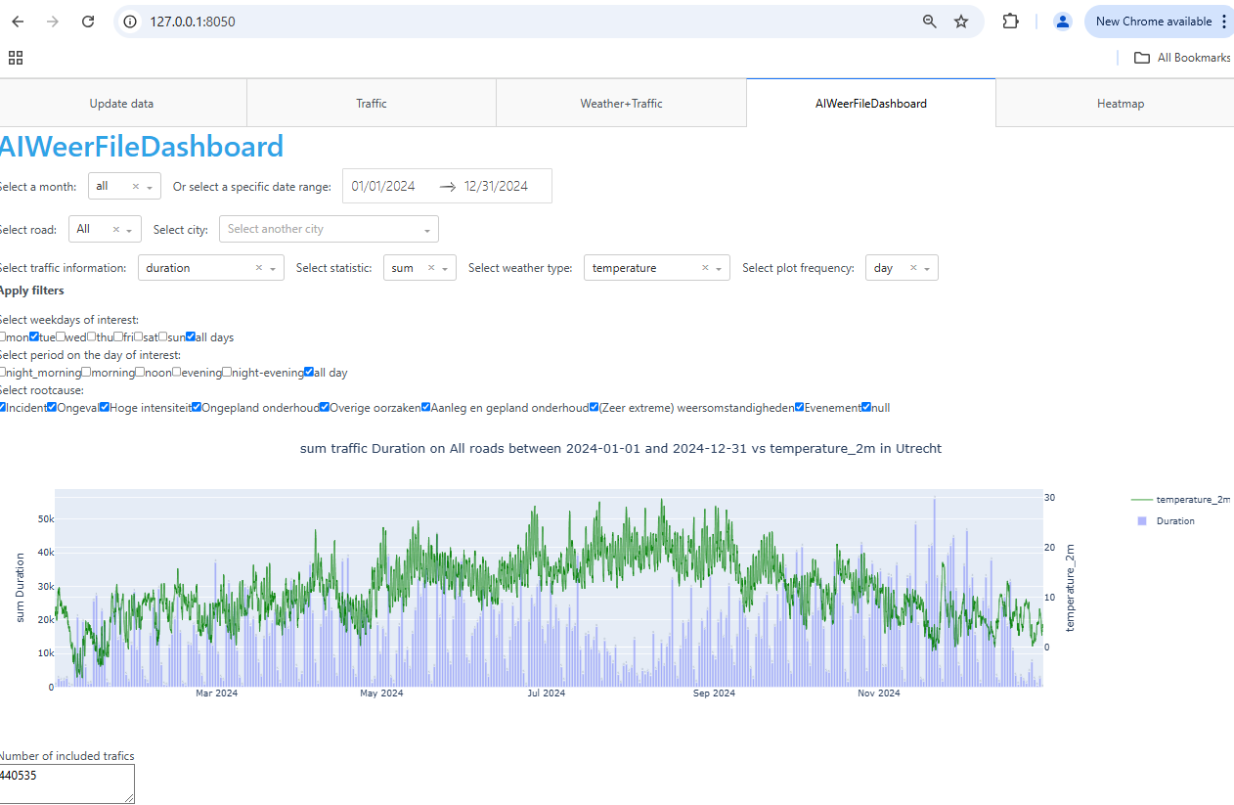
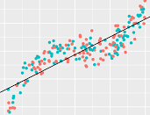






AIWeerFile
Design
Data Collection
Data cleaning
Data storage
Data visualization
Data modelling
csv
Traffic data
downloads.rijkswaterstaatdata.nl
API
City coordinates
https://geocoding-api
API
Weather data
https://open-meteo.com/

Slide 8

AIWeerFile
Design
Data Collection
Data cleaning
Data storage & Request
Data visualization
Data modelling
csv
Traffic data
downloads.rijkswaterstaatdata.nl
API
CAN BE SLOW
City coordinates
https://geocoding-api
API
Weather data
https://open-meteo.com/
Update data

Slide 9

AIWeerFile
Design
Data Collection
Data cleaning
Data storage & Request
Data visualization
Data modelling
csv
Traffic data
downloads.rijkswaterstaatdata.nl
API
City coordinates
https://geocoding-api
API
Weather data
https://open-meteo.com/
Update pickle
Update data

Slide 10
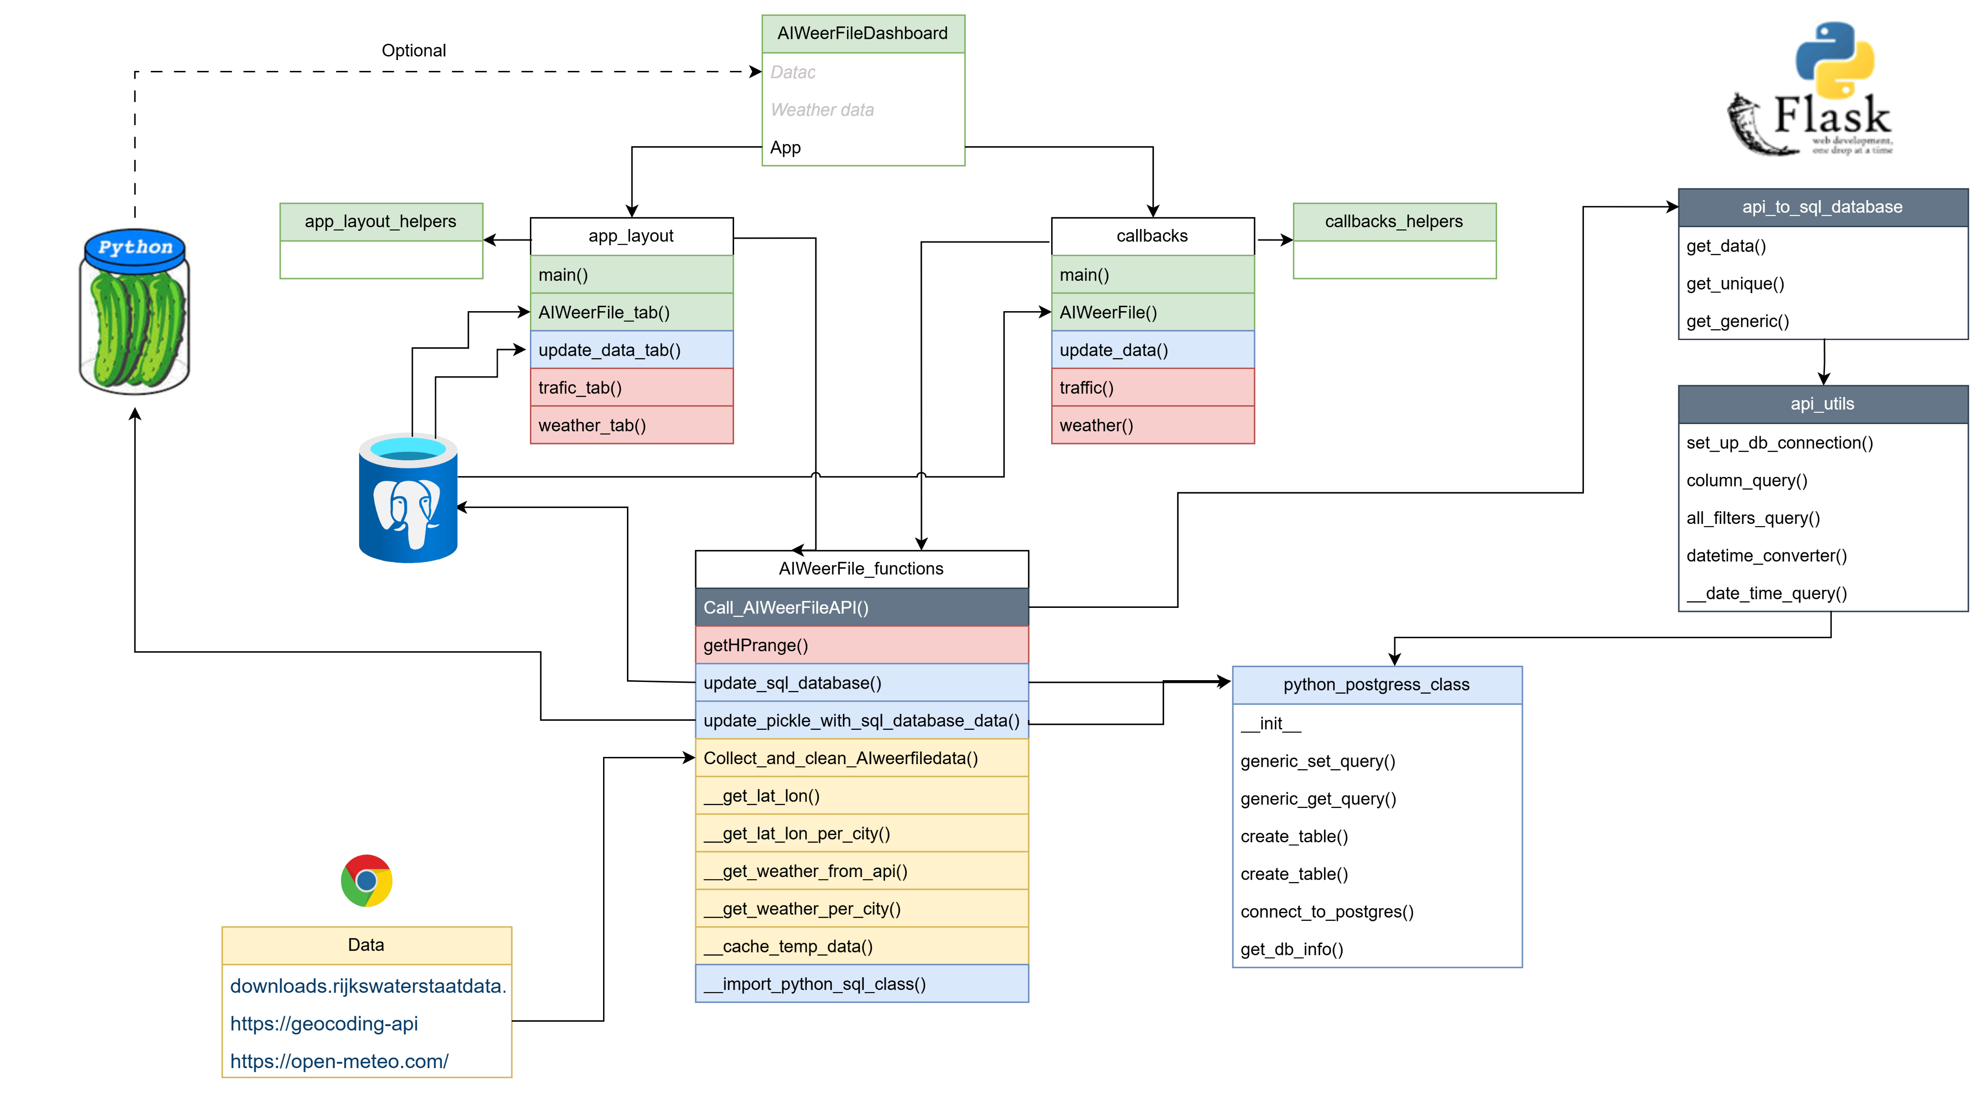
AIWeerFile
Design

Slide 11
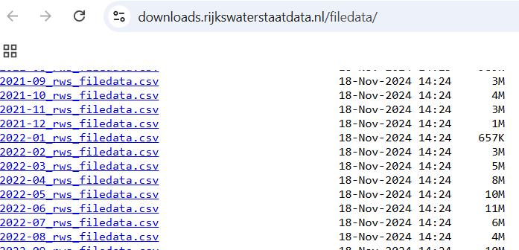
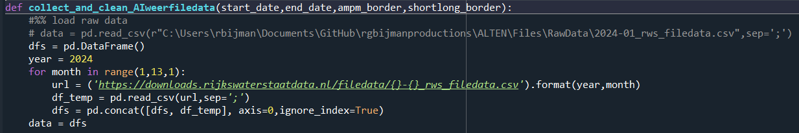
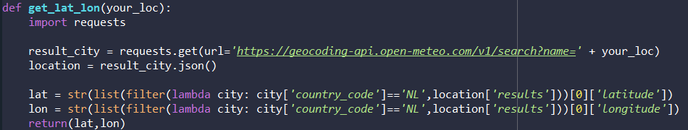
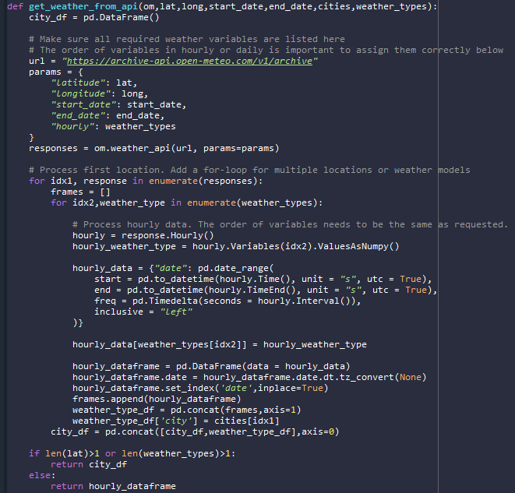
AIWeerFile
Design
Data Collection
csv
Traffic data
downloads.rijkswaterstaatdata.nl
API
City coordinates
https://geocoding-api
API
Weather data
https://open-meteo.com/

Slide 12
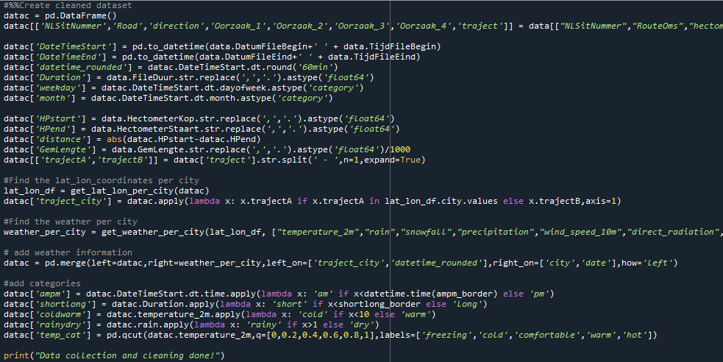
AIWeerFile
Design
Data cleaning

Slide 13
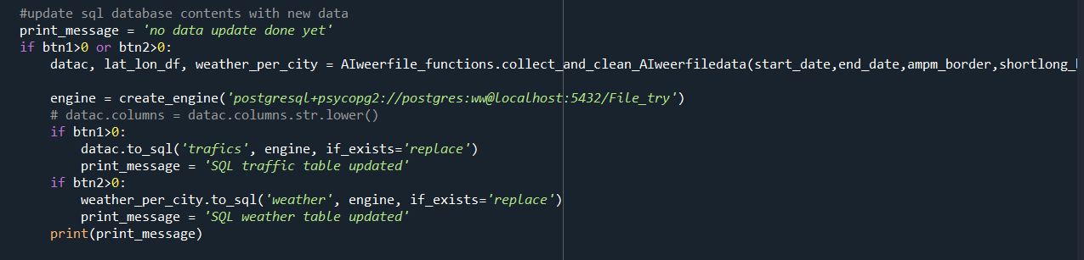
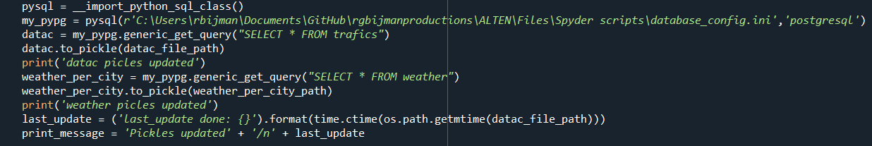
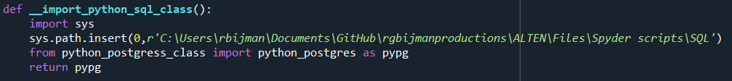
AIWeerFile
Design
Data storage

Slide 14
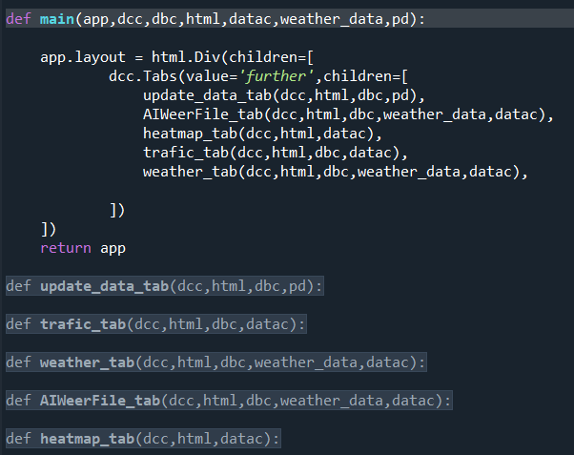
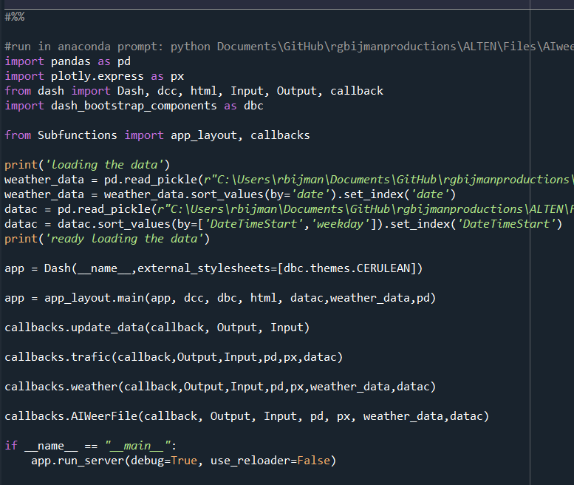
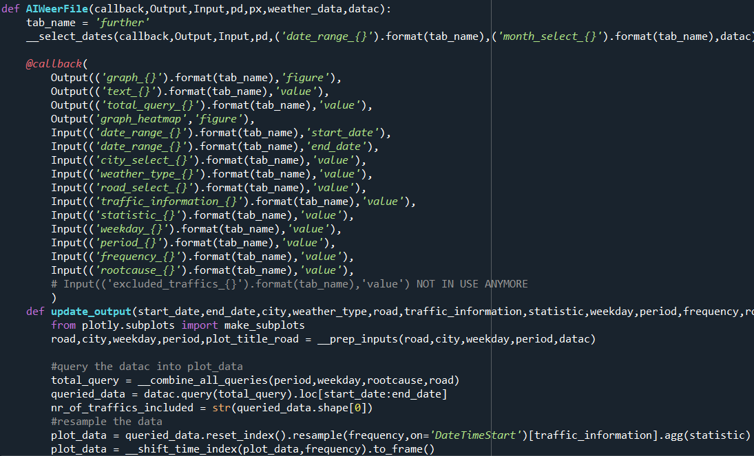
AIWeerFile
Design
Data visualization

Slide 15

AIWeerFile
Design
Data modelling

Slide 16

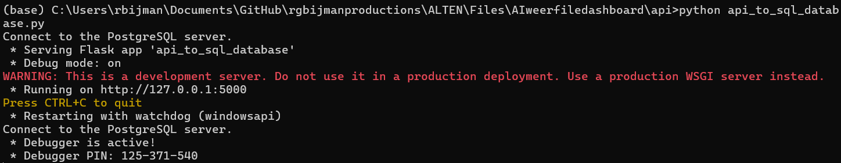
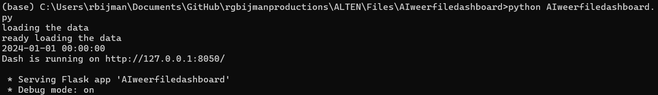
AIWeerFile
DEMO
API start
Dashboard start

Slide 17
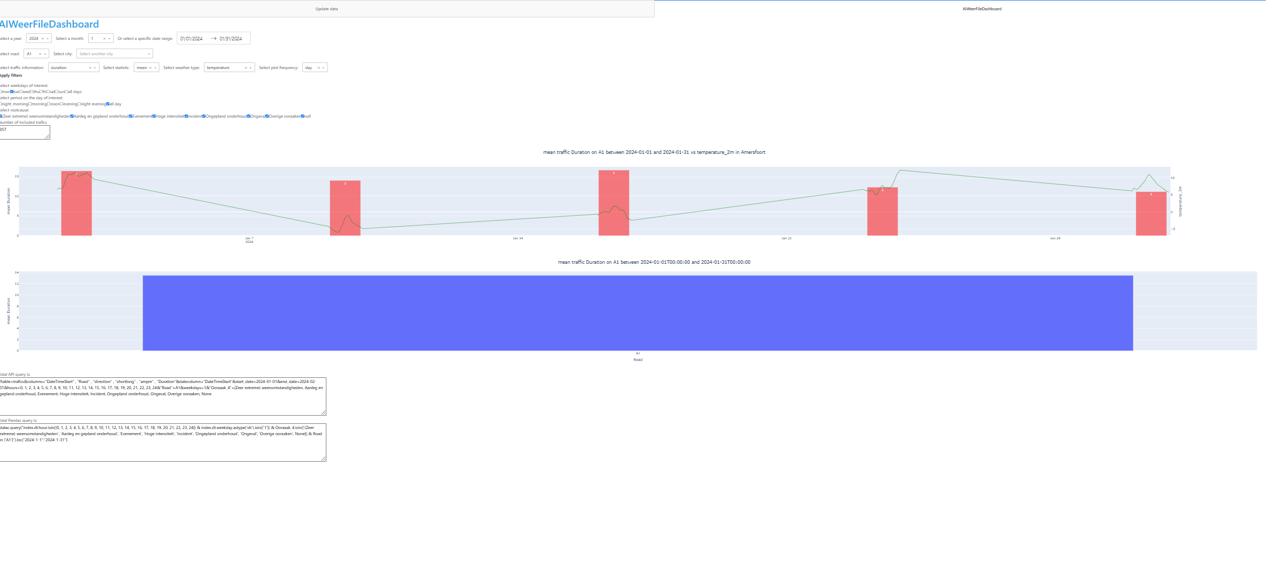
AIWeerFile
DEMO

Slide 18
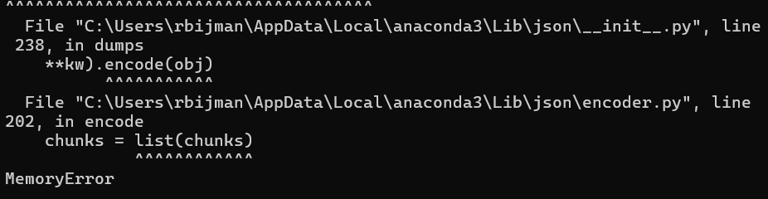

Slide 19
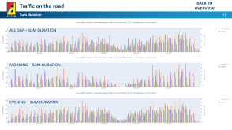
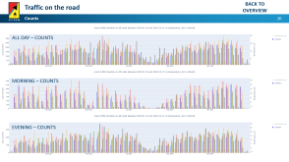
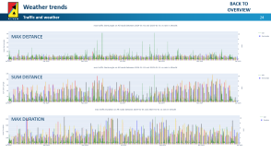
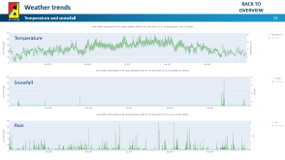

AIWeerFile
Hypothesis testing
Traffic and Weather correlation
Basic Traffic information
Tuesdays/Thursdays are the most busy days on the road
Weekend days are the least busy days on the road
Summer time is less busy on the road
Basic Weather information
Temperature is highest in summer
Snow only occurs in winter months
Rain showers are more intense in summer
Correlations Traffic and Weather data
We see more traffic when it is raining
We see longer traffic when it is raining
Sum duration
Count
Sum distance
Weather info
Correlations Weather-Traffic

Slide 20
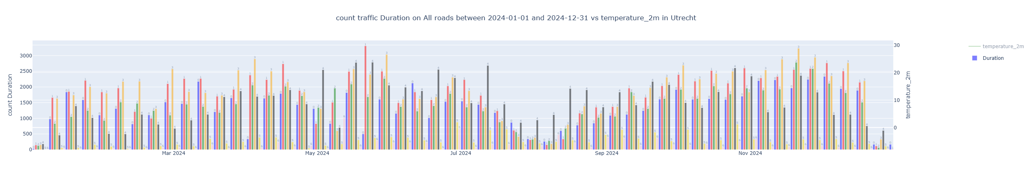
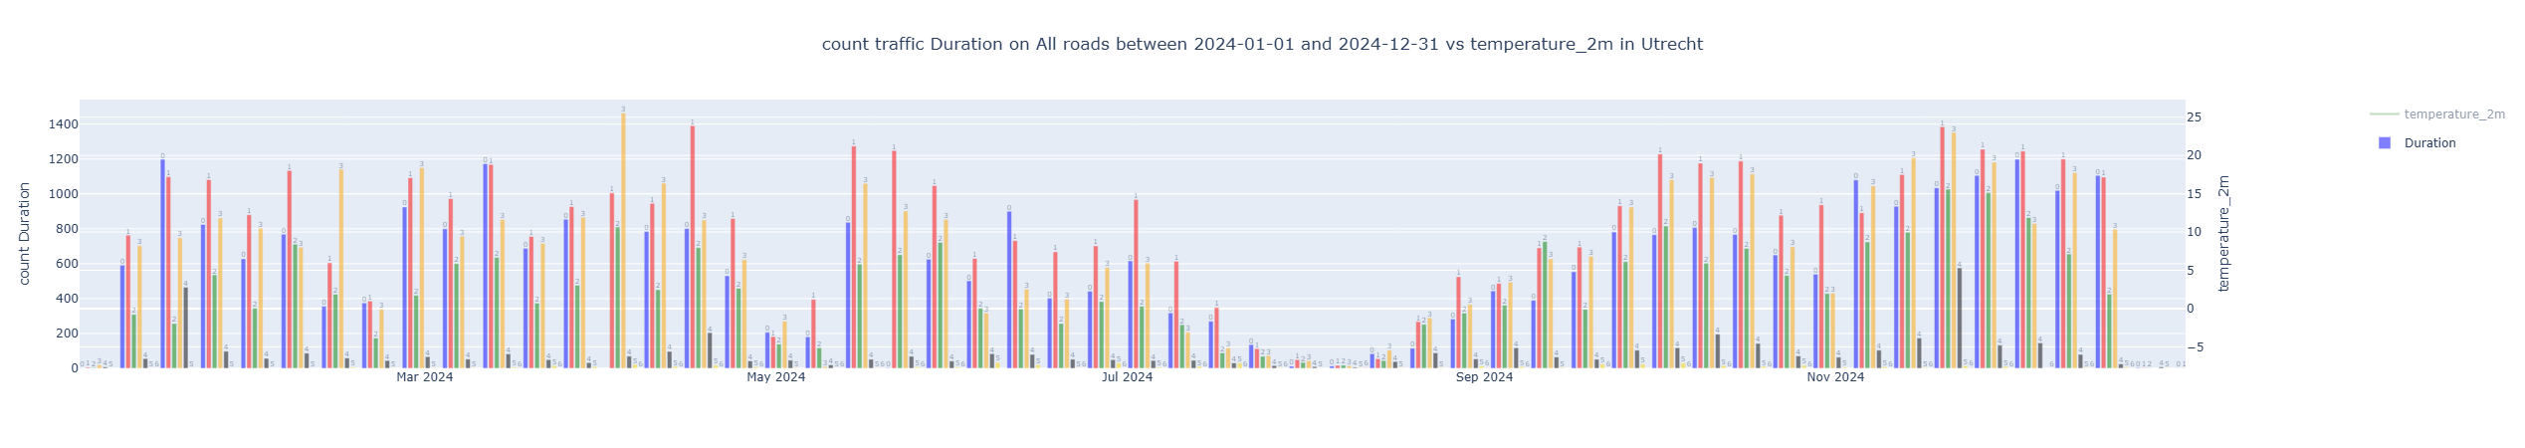
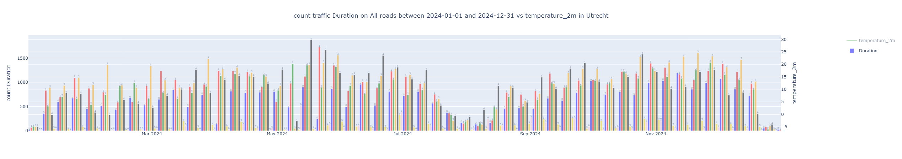
BACK TO OVERVIEW
Traffic on the road
Counts
ALL DAY – COUNTS
MORNING – COUNTS
EVENING – COUNTS

Slide 21
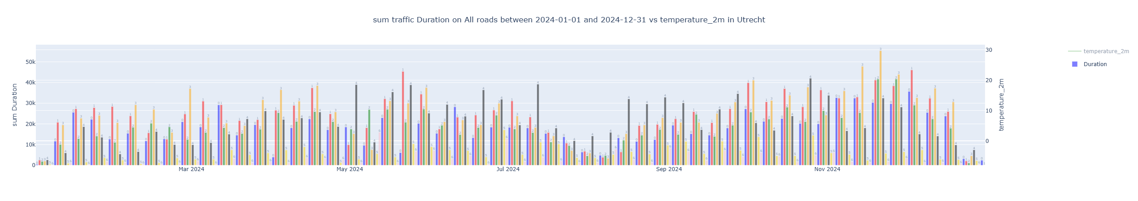
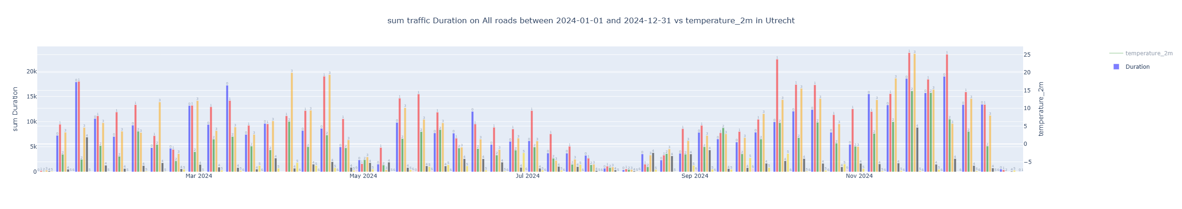
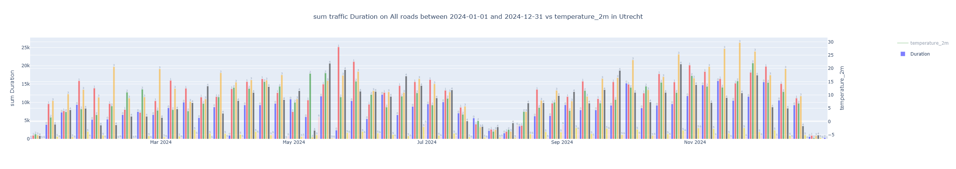
BACK TO OVERVIEW
Traffic on the road
Sum duration
ALL DAY – SUM DURATION
MORNING – SUM DURATION
EVENING – SUM DURATION

Slide 22
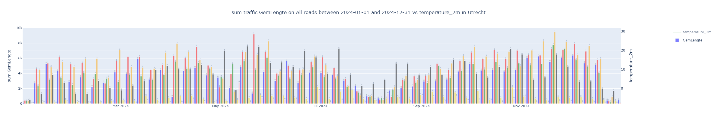
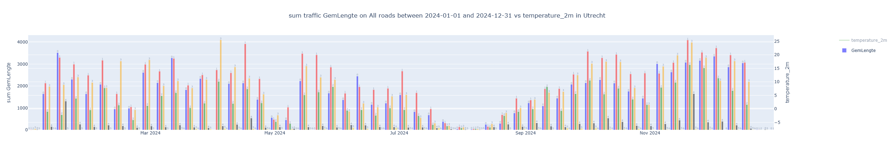

BACK TO OVERVIEW
Traffic on the road
Sum length
ALL DAY – SUM DISTANCE
MORNING – SUM DISTANCE
EVENING – SUM DISTANCE

Slide 23
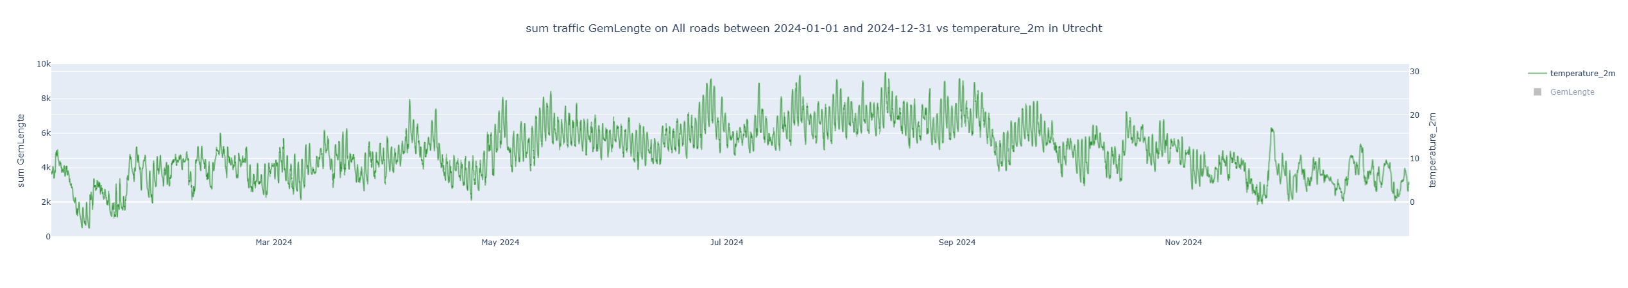
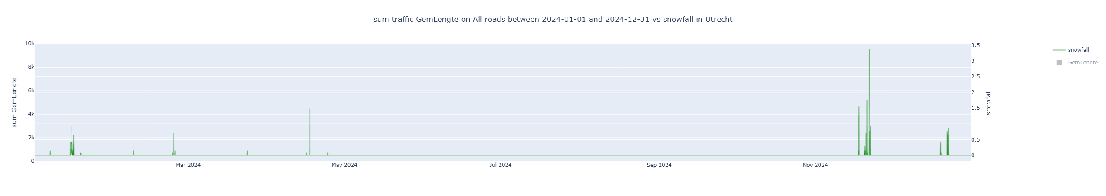
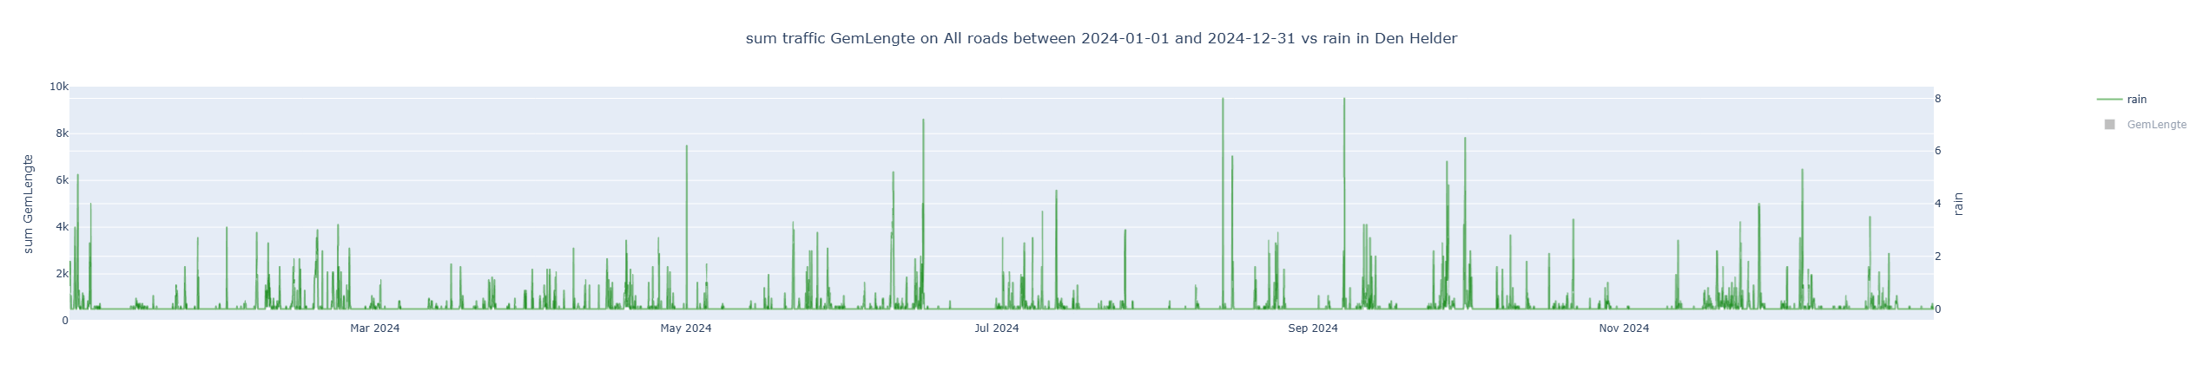
BACK TO OVERVIEW
Weather trends
Temperature and snowfall
Temperature
Snowfall
Rain

Slide 24
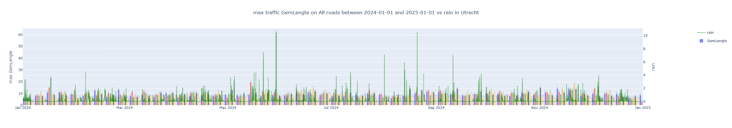
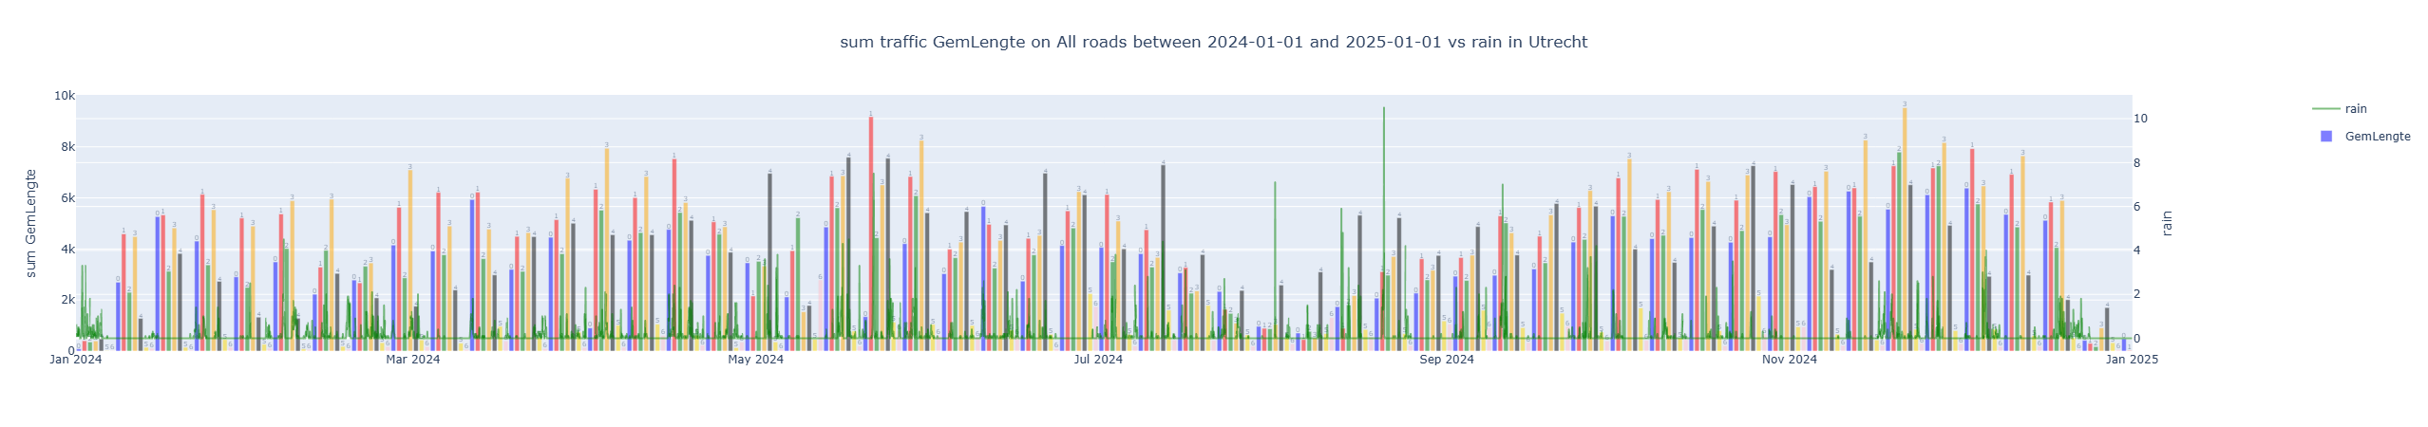
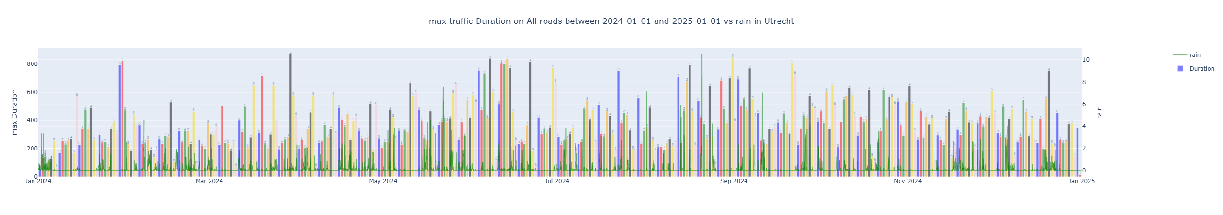
BACK TO OVERVIEW
Weather trends
Traffic and weather
MAX DISTANCE
SUM DISTANCE
MAX DURATION

Slide 25
AIWeerFile
Next steps
TODO
Do more in-depth investigations and build predictive model
Write README!!!!!
Make auto testers
Add data of more years
Investigate the use of classes instead of functions for app_layout and callbacks
Weather data per day/month instead of always per hour
Investigate other plotting methods

Slide 26
AIWeerFile
Next steps
NICE to haves
Add setting templates and put the detailed settings somewhere in the back
Add visual where the traffics are on the map
Split the callbacks, to make dashboard faster??
Add clickable to have traffic per HM insights

